Slide 1
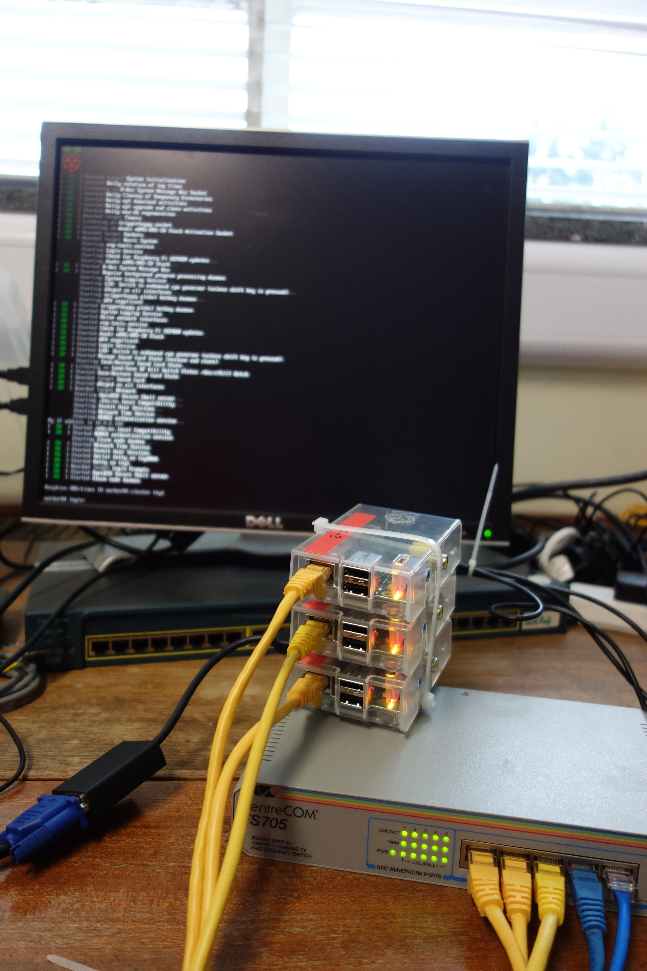


Introducing High Performance Computing with the Raspberry Pi
A practical use of and good excuse to build Raspberry Pi Clusters
Colin Sauzé <cos@aber.ac.uk>
Research Software Engineer
Super Computing Wales Project
Aberystwyth University

Slide 2
Overview
About Me
Inspirations
Why teach HPC with Raspberry Pi?
My Raspberry Pi cluster
Experiences from teaching
Future Work

Slide 3





About Me
Research Software Engineer with Supercomputing Wales project
  4 university partnership to supply HPC systems
  Two physical HPCs
PhD in Robotics
  Experience with Linux on single board computers
  Lots of Raspberry Pi projects

Slide 4
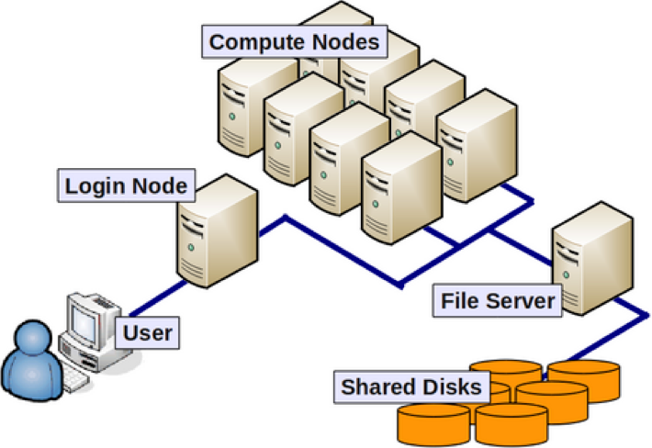
What is High Performance Computing?
Using lots of computers together
  Usually high end servers
  10s of cores per server
  100s of gigabytes of memory
  High speed network
Login nodes
  Users login to these
  Submit jobs to compute nodes
  Job management/queueing
Storage nodes
  Large hard disks
  100s or 1000s of Terrabytes
Almost always Linux based
  Typically running RHEL/CentOS

Slide 5
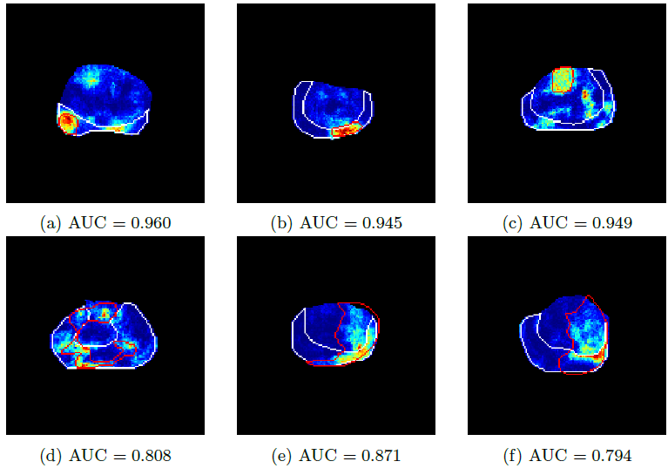
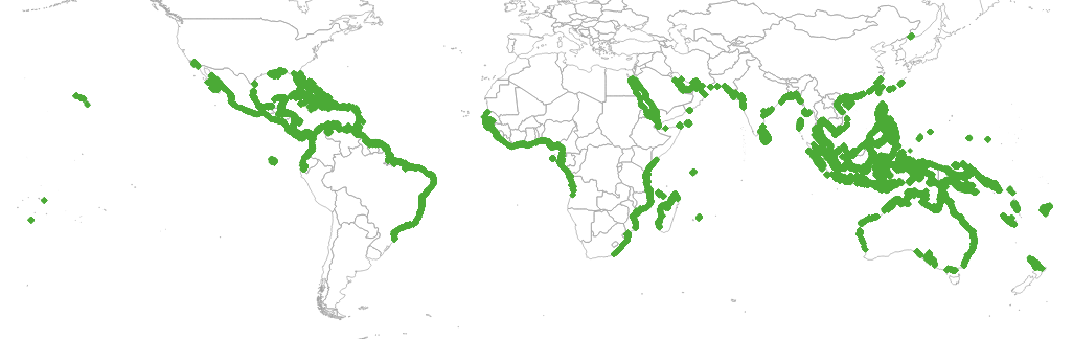





What is High Performance Computing used for?
Solving big scientific computing problems:
  Physics/engineering simulations
  Weather Forecasting
  Seismic modelling
“Big data” problems:
  Matching Gene Sequences
  Analysing Satellite Images
  Training AI neural networks
From Zwiggelaar and Wang (2017), “3D Texton Based Prostate Cancer Detection Using Multiparametric Magnetic Resonance Imaging”, Medical Image Understanding and Analysis 2017

Slide 6
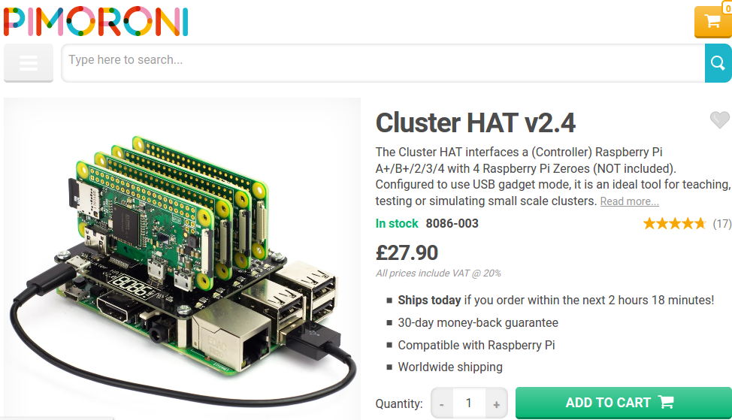
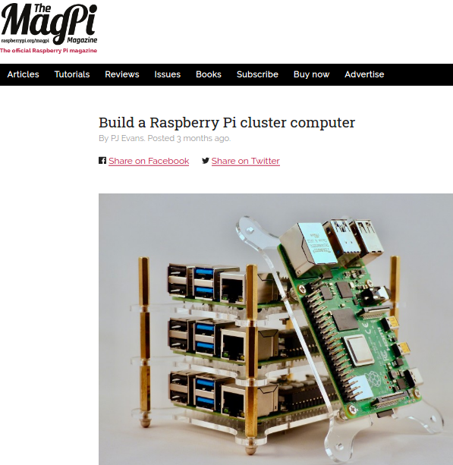
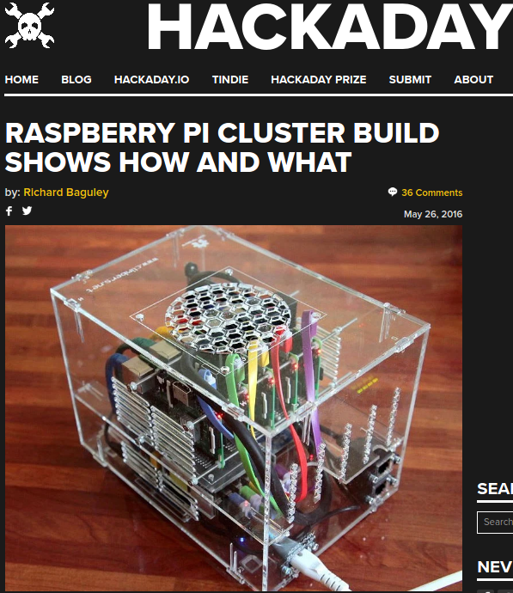
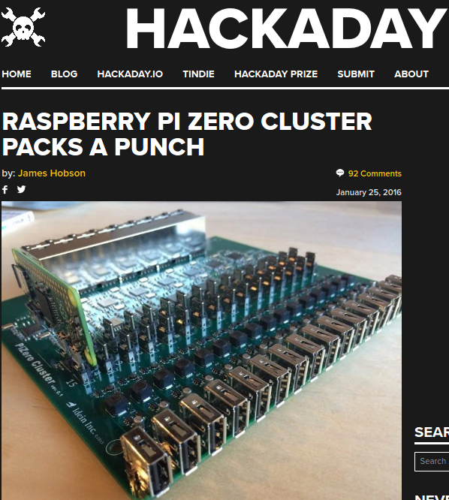
Where does the Raspberry Pi fit in?

Slide 7
Where does the Raspberry Pi fit?
Not really suited to HPC:
  CPU not very fast
  Network is slow
    100 or 1000 mbit/sec
    Often fails to reach this
  Storage speeds limited by USB
  Only 256MB RAM per core on Pi2/3
But:
  Its cheap
  Simple
  Power efficient
  Runs a full Linux OS
  All the software we use on a “real” HPC is available

Slide 8
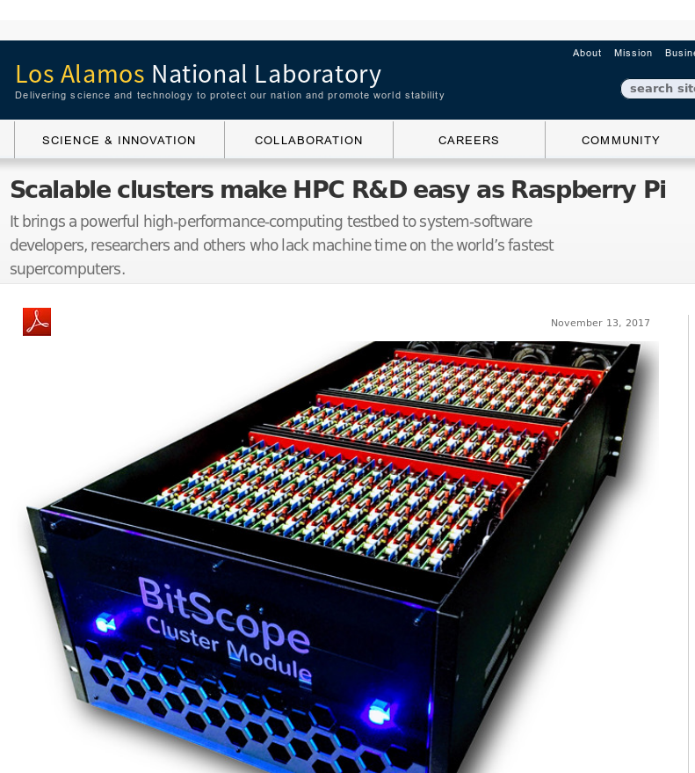
Inspiration #1: Los Alamos National Laboratory
750 node cluster
Test system for software development
Avoid tying up the real cluster

Slide 9
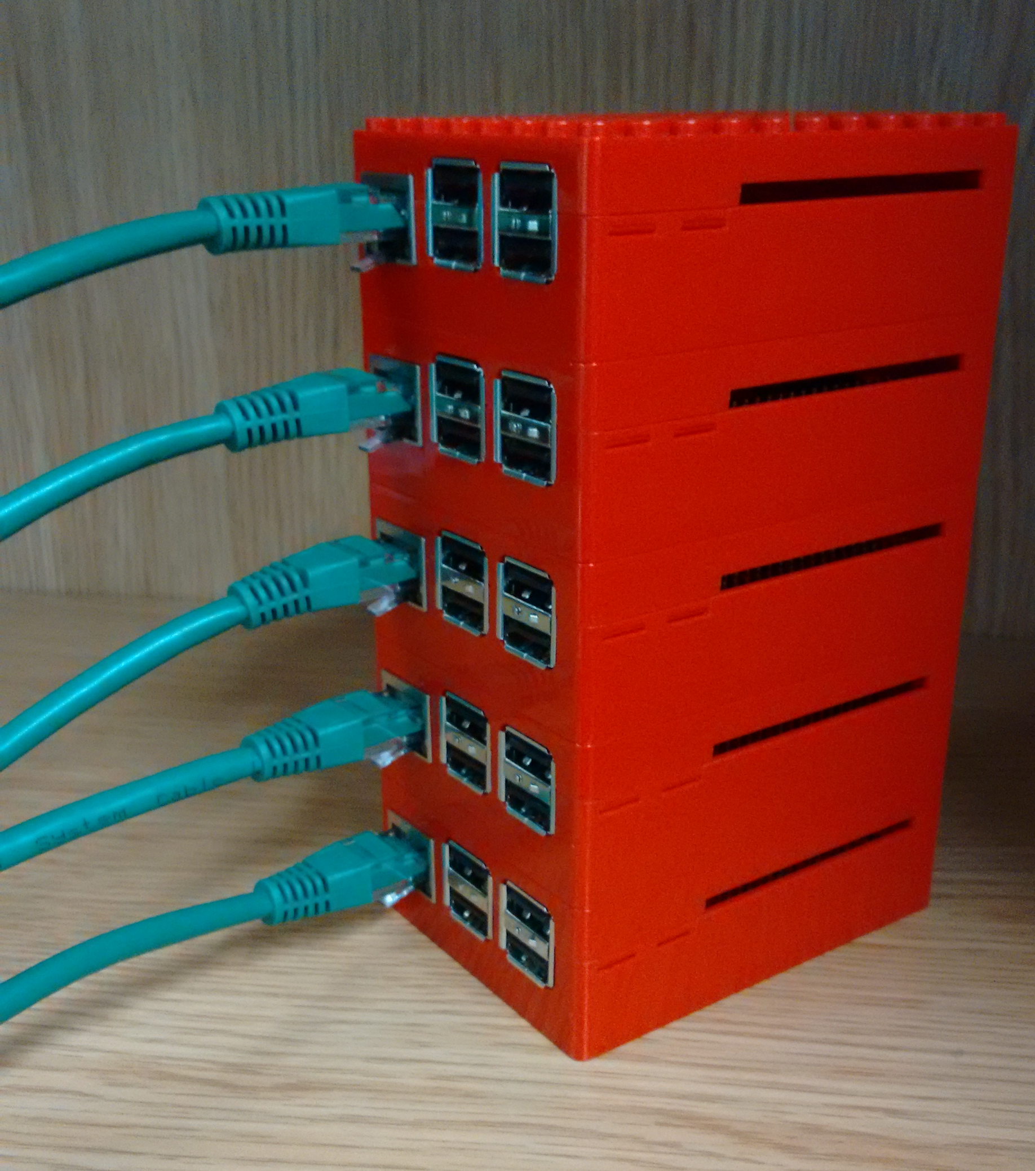
Inspiration #2: Wee Archie/Archlet
EPCC’s Raspberry Pi Cluster
Archie: 18x Raspberry Pi 2’s (4 cores each)
Archlet: smaller 4 or 5 node clusters.
Used for outreach demos.
Setup instructions: https://github.com/EPCCed/wee_archlet
Image from https://raw.githubusercontent.com/EPCCed/wee_archlet/master/images/IMG_20170210_132818620.jpg

Slide 10
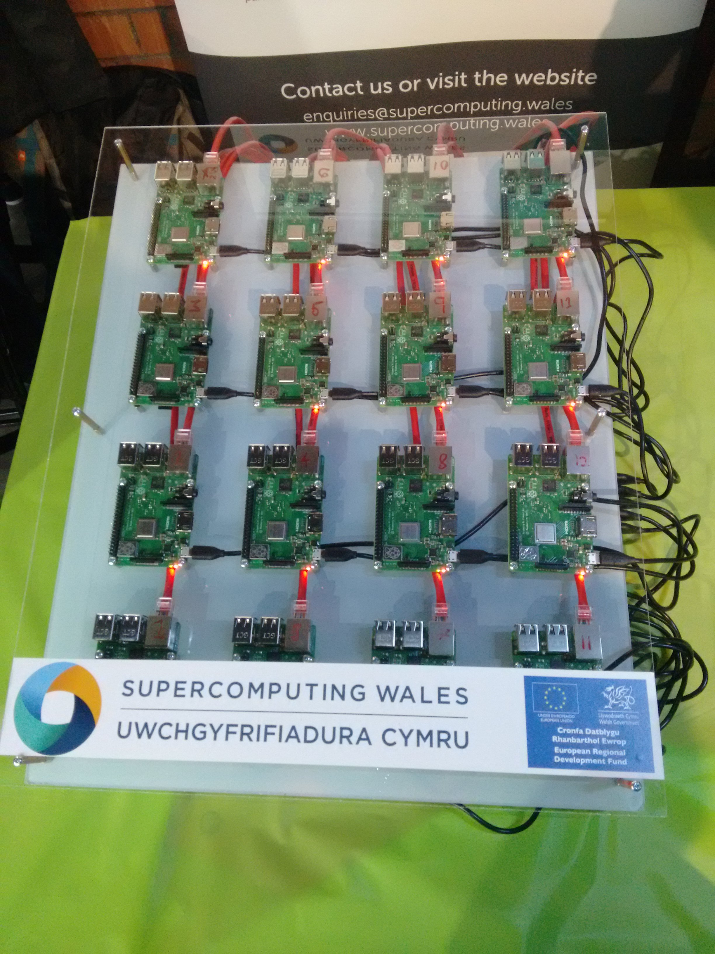
Inspiration #3: Swansea’s Raspberry Pi Cluster
16x Raspberry Pi 3s
CFD demo using a Kinect sensor
Demoed at the Swansea Festival of Science 2018

Slide 11
Why Teach with a Raspberry Pi cluster?
Avoid loading real clusters doing actual research
  Less fear from learners that they might break something
  Daunting using a multi million £ system for the first time
Resource limits more apparent
More control over the environment
Hardware less abstract
No need to have accounts on a real HPC

Slide 12
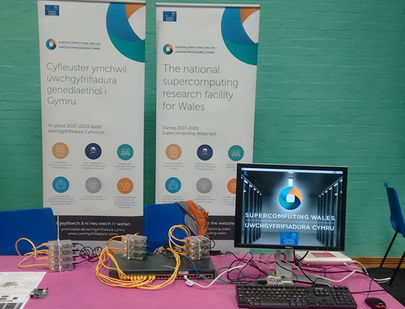
My Cluster
“Tweety Pi”
  10x Raspberry Pi model B version 1s
  1x Raspberry Pi 3 as head/login node
  Raspbian Stretch
Head node acts as WiFi access point
  Internet via phone or laptop

Slide 13
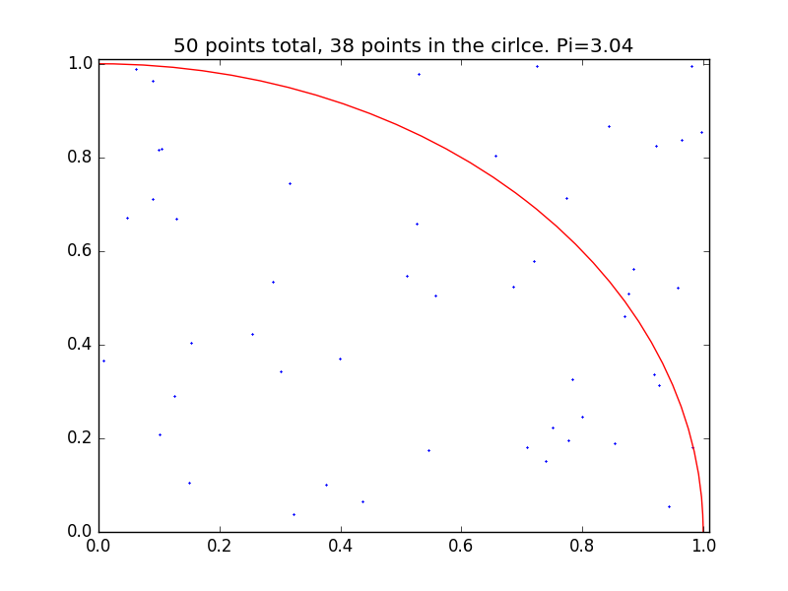
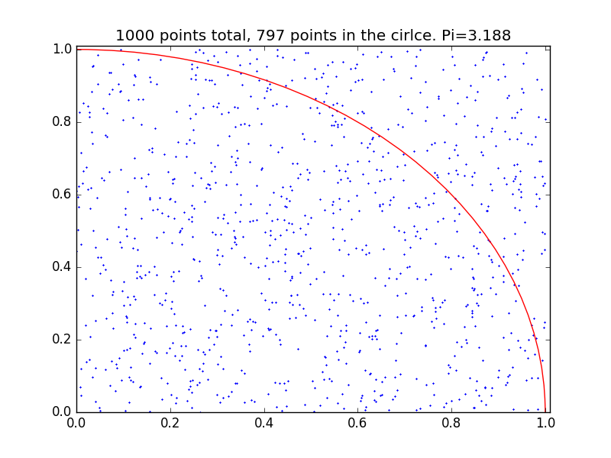
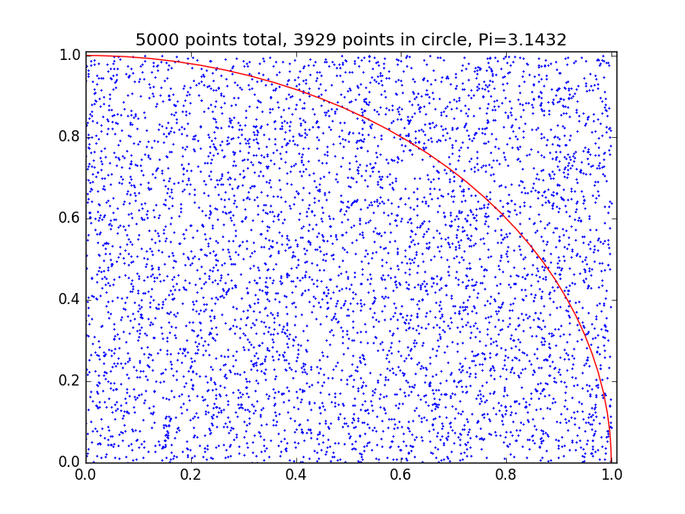

Demo Software
British Science Week 2019
  Simple Pi with Monte Carlo methods demo
  MPI based
  GUI to control how many jobs launch and show queuing
Swansea CFD demo
  Needs more compute power
  16x Raspberry Pi 3 vs 10x Raspberry Pi 1
Wee Archie/Archlet Demos
  Many demos available
    I only found this recently
  https://github.com/EPCCed/wee_archie

Slide 14
Making a realistic HPC environment
MPICH
Slurm
Quotas on home directories
NFS mounted home directories
Software modules
Network booting compute nodes

Slide 15
Network booting hack
No PXE boot support on original Raspberry Pi (or Raspberry Pi B+ and 2)
Kernel + bootloader on SD card
Root filesystem on NFS
  Cmdline.txt contains:
    console=tty1 root=/dev/nfs nfsroot=10.0.0.10:/nfs/node_rootfs,vers=3 ro ip=dhcp elevator=deadline rootwait
SD cards can be identical, small 50mb image, easy to replace

Slide 16

Teaching Materials
Based on Introduction to HPC with Super Computing Wales carpentry style lesson:
  What is an HPC?
  Logging in
  Filesystems and transferring data
  Submitting/monitoring jobs with Slurm
  Profiling
  Parallelising code

Slide 17
Experiences from Teaching
Run twice: Summer school and standard training session
  Some Unix/Linux experience
  Little or No HPC experience
Good to see real hardware
Work around delays creating accounts
Environment pretty much the same, all teaching material worked on either system
Limits very obvious due to small size
Learners more adventurous

Slide 18
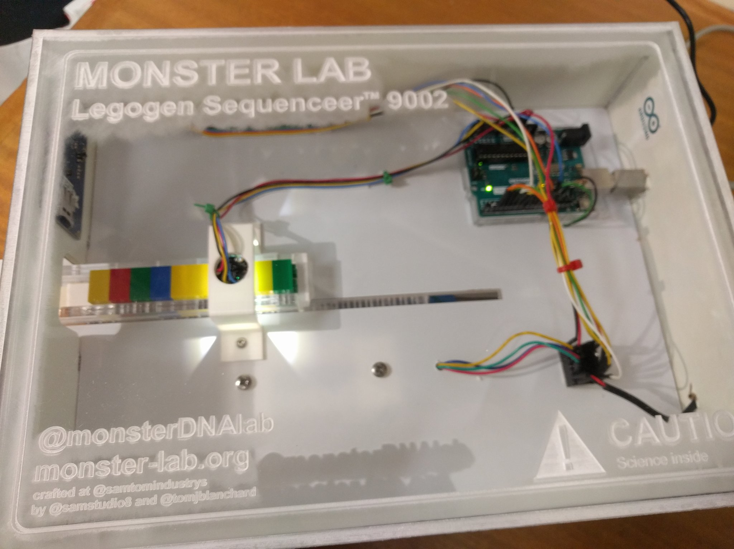
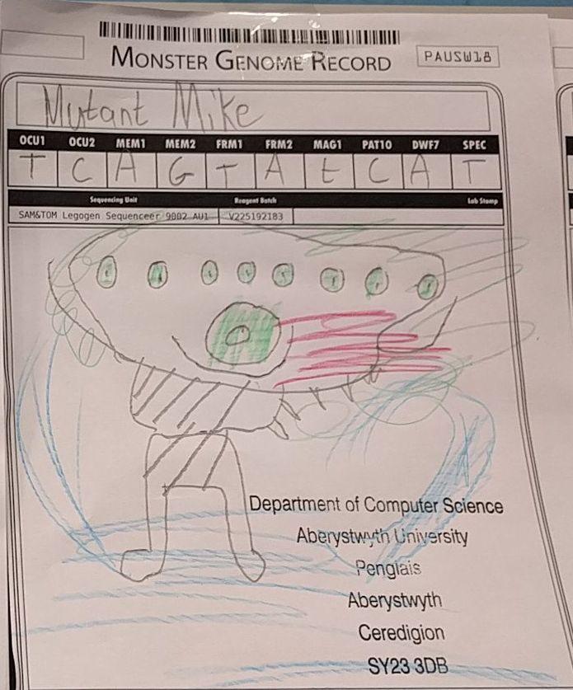
Future Work
Configuration management tool (Ansible/Chef/Puppet/Salt etc) instead of script for configuration
CentOS/Open HPC stack instead of Raspbian
Public engagement demo which focuses on our research
  Analysing satellite imagery
  Simulate the monsters from MonsterLab (https://monster-lab.org/)

Slide 19
More Information
Setup instructions and scripts - https://github.com/colinsauze/pi_cluster
Teaching material - https://github.com/SCW-Aberystwyth/Introduction-to-HPC-with-RaspberryPi
Email me: cos@aber.ac.uk

